Slide 1
Spatial accessibility to the COVID-19 testing sites and the driven factors behind in NYC
Final Presentation
Kelly Anran Zheng

Slide 2

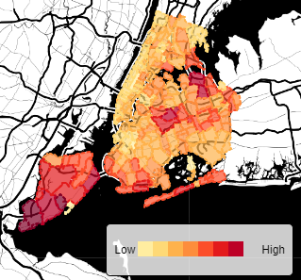

Background
Problems with existing research:
Lack of research on a micro-level region
most studies only considered one travel mode rather than mulitimodal
very few studies explored the driven factors of spatial accessibility to medical resources
Notes:
Testing site is one important public facility in the prevention of COVID-19.
Literature review. Although there is lots of studies on the measurement of spatial accessibility to health care services
Many research focuses on the county level of accessibility measurement of a whole state. However, investigating a micro-level region will be more meaningful because in reality, people tend to travel across tracts rather than counties to access the COVID-19 medical resources timely.
, most studies only considered one travel mode, especially driving, in the measurement of accessibility. But when accounting for a city, accessibility by different transit modes (personal vehicles, walking and public transit) should be analyzed and compared since multimodal network is a fundamental component of a city
…

Slide 3
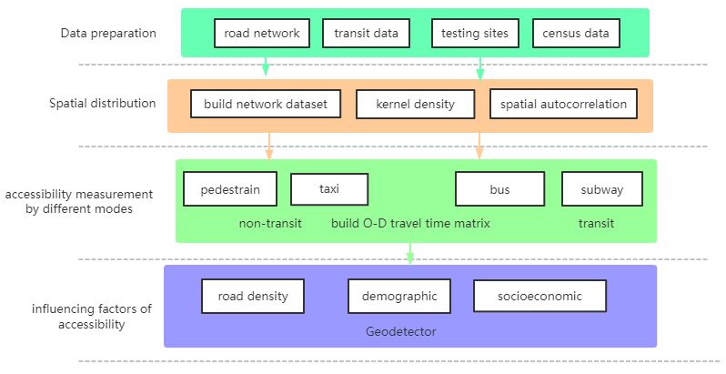
Methods
Notes:
Based on these problems… four most common travel patterns in NYC, including walking, driving, subway and bus, are compared based on the O-D travel time matrix of ArcGIS Network Analyst

Slide 4
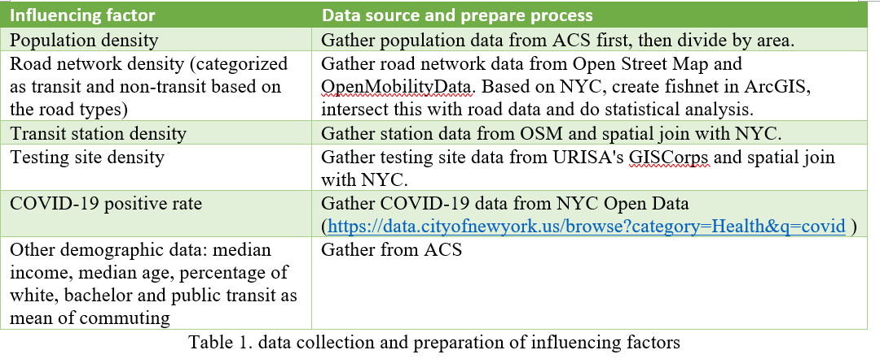
Data

Slide 5
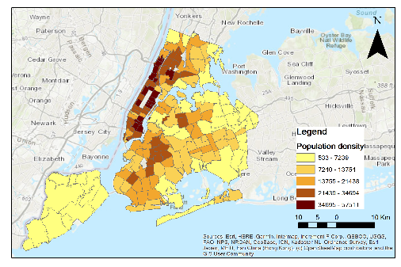
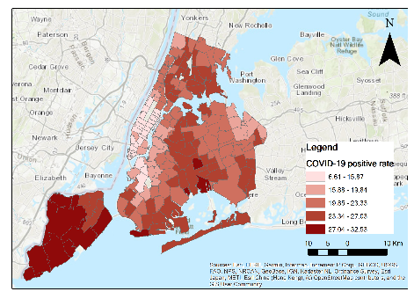
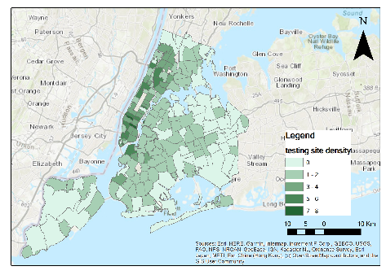
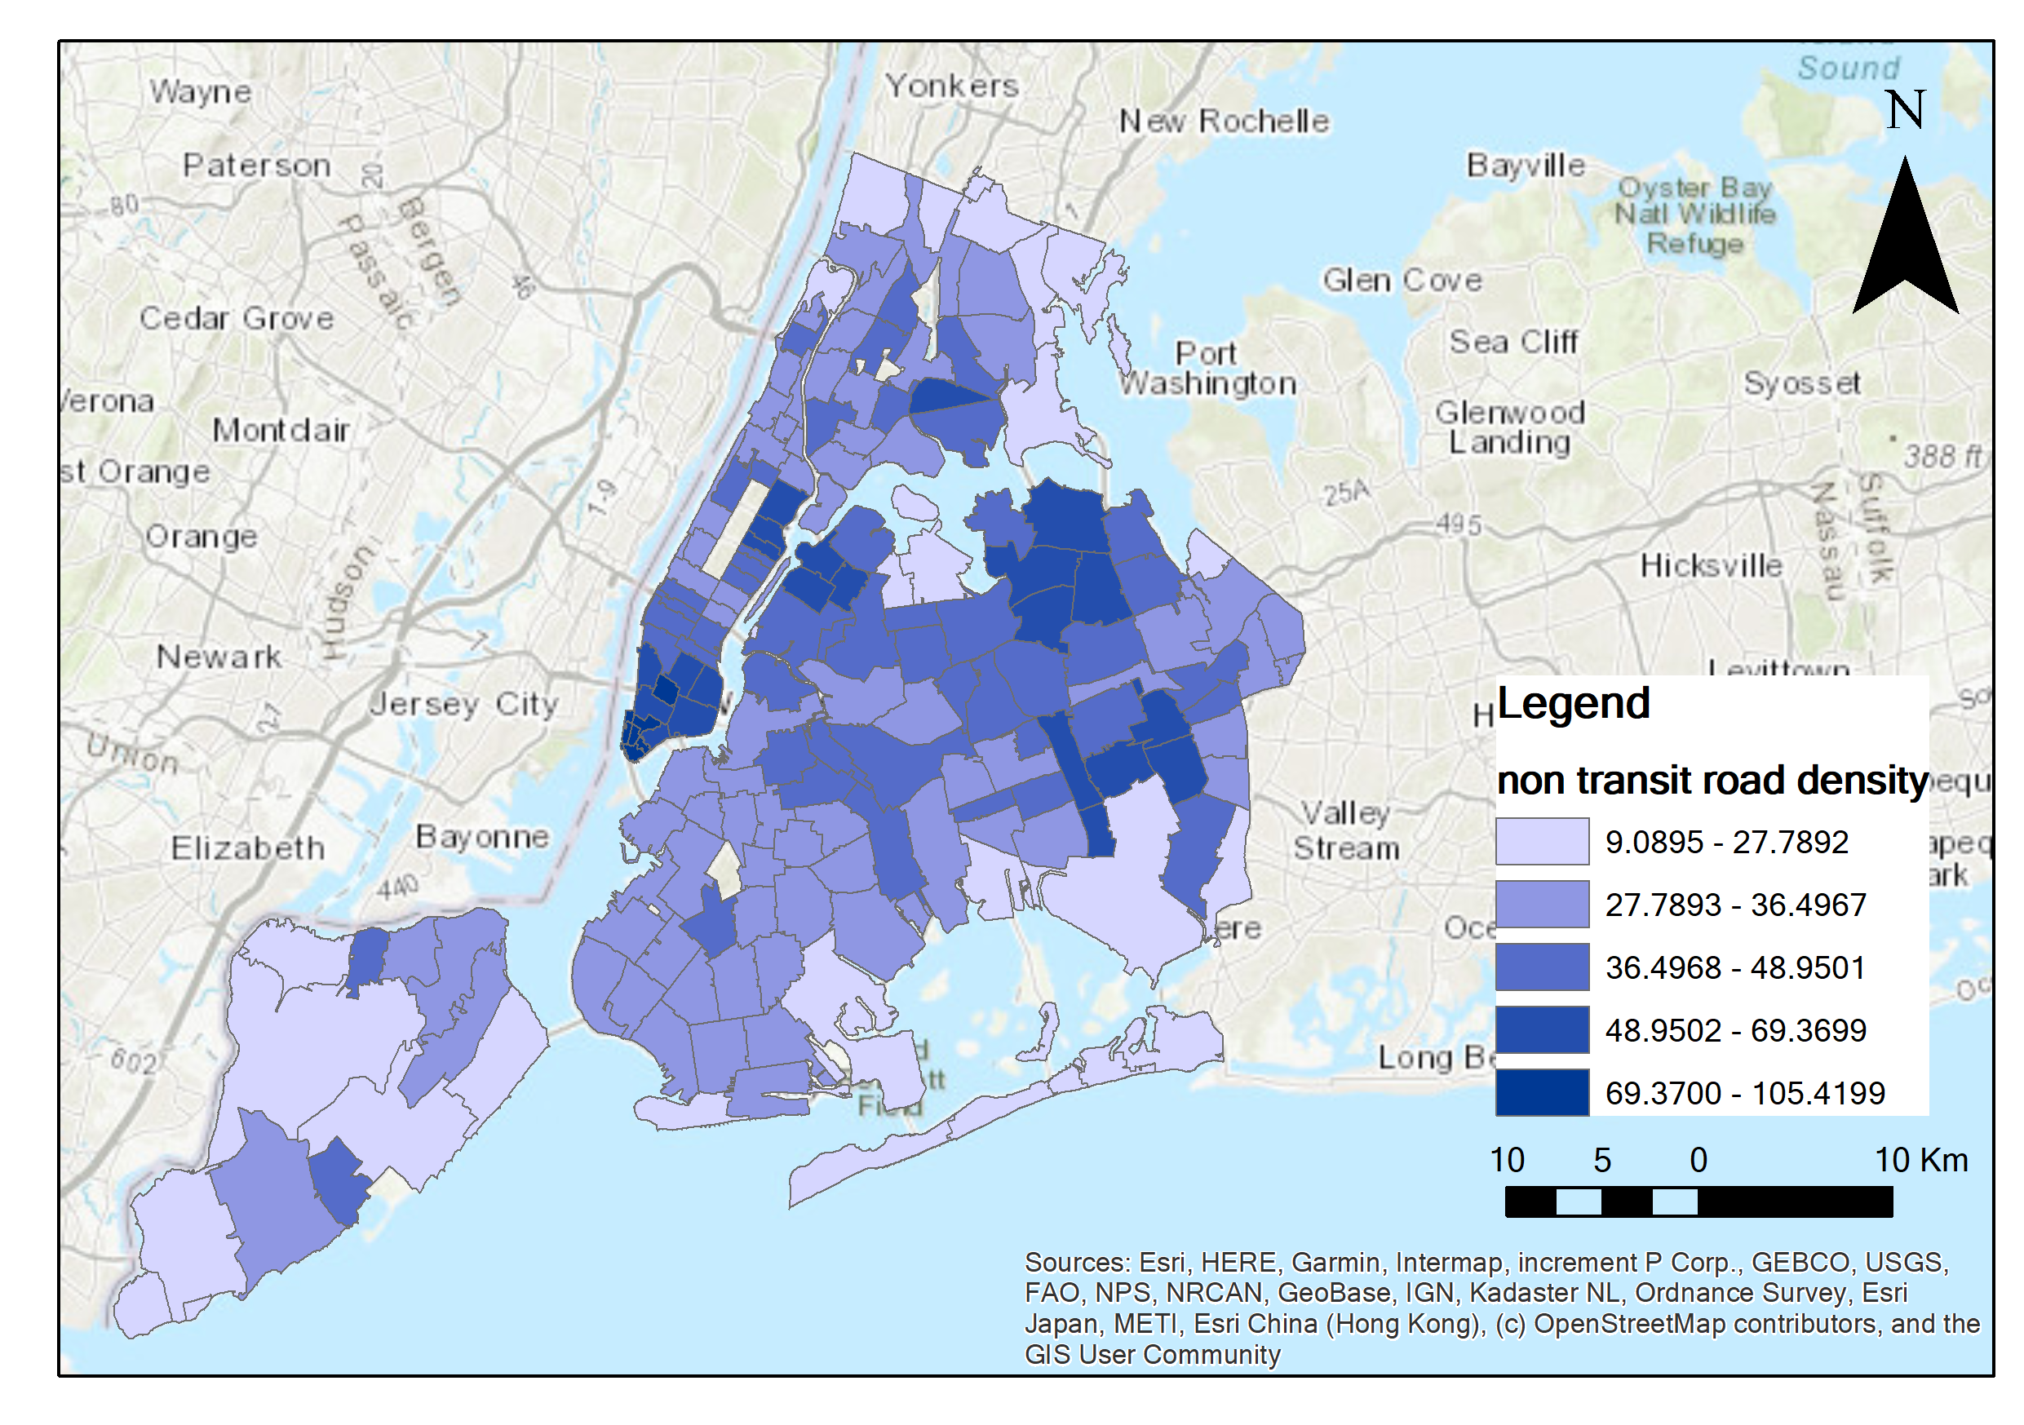
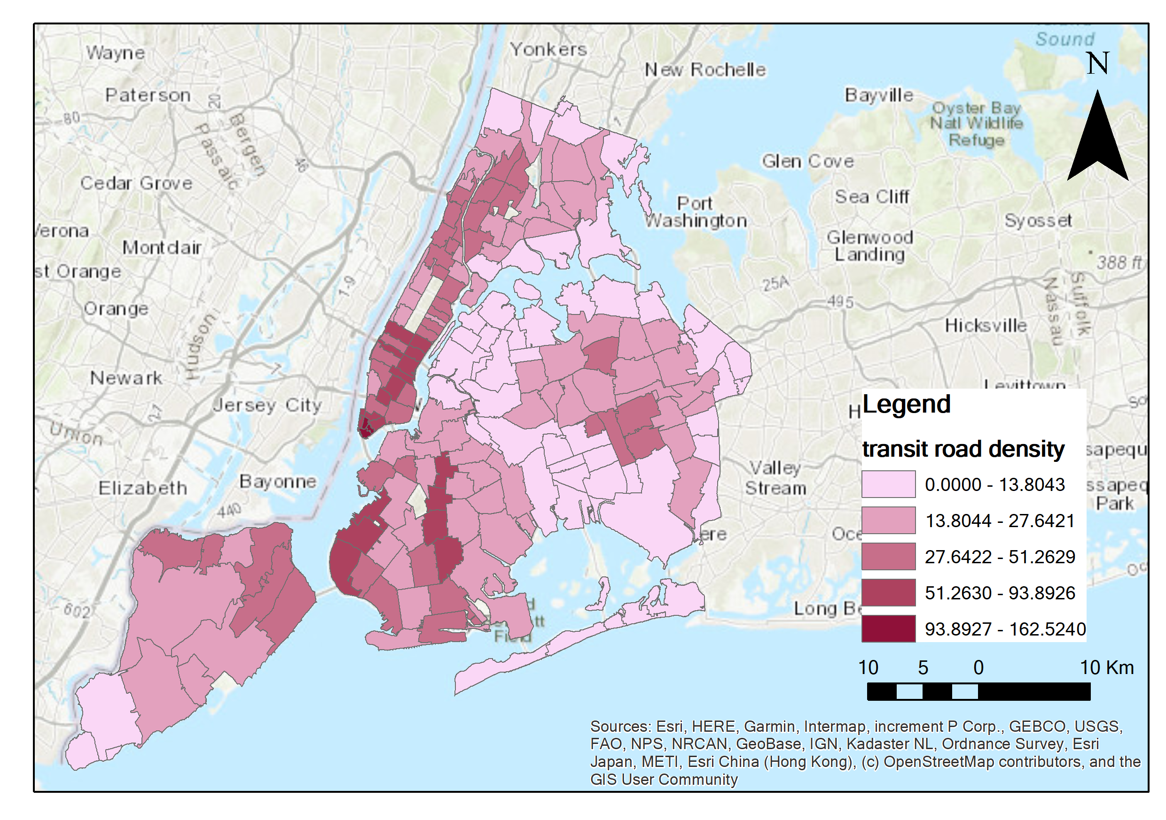
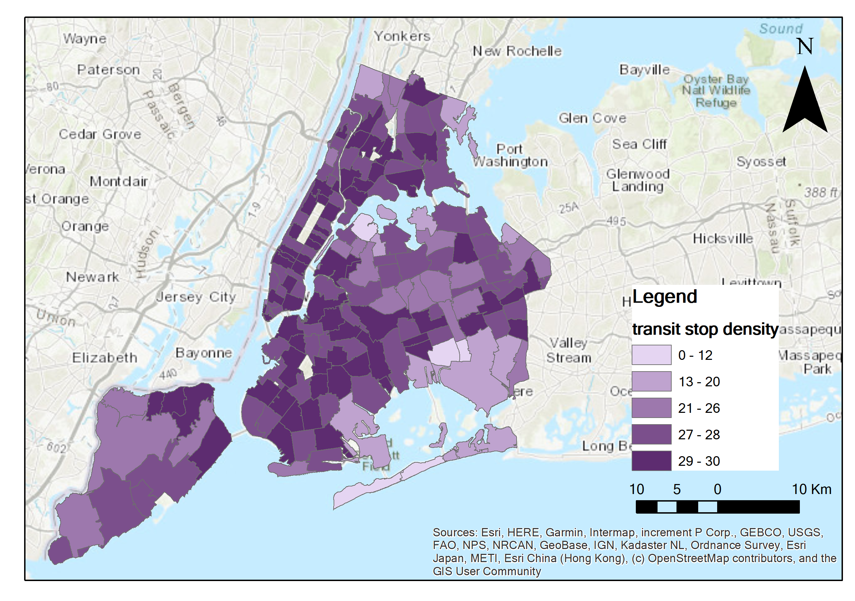
Data

Slide 6
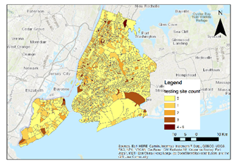
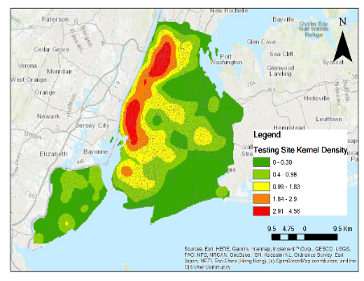
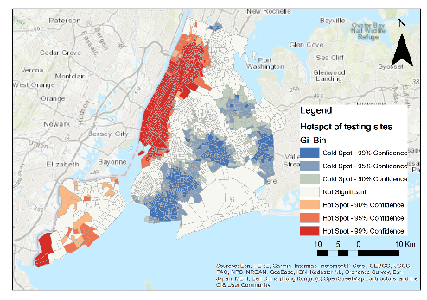
Spatial distribution
(a) (b) (c)
the spatial distribution of COVID-19 testing sites in NYC: (a) count of testing sites contained in each tract. (b) kernel density estimation of testing sites. (c) hotspots of testing sites
Notes:
Spatial autocorrelation and kernel density estimation methods
the testing sites are spatially clustered in NYC.

Slide 7
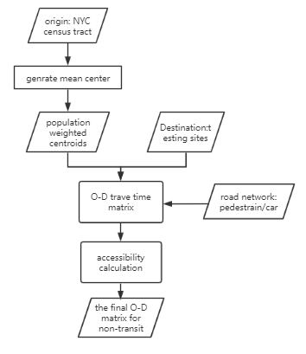
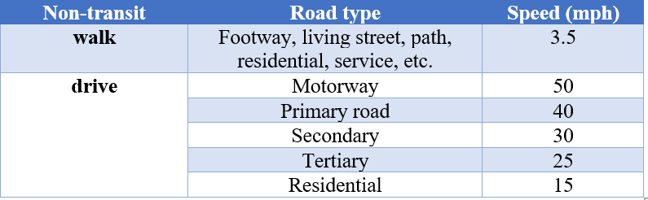
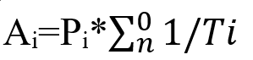
Accessibility: non-transit
Ai=Pi*∑_n^0▒〖1/Ti〗
Where Ai is the accessibility of census tract i, Pi is the total population number of census tract i, n is number of testing sites that people can access within 15 minutes and Ti is the time people spend getting to each testing site.
Notes:
Walking and driving are categorized into non-transit mode.
技术路线，key step: build road network and OD matrix
Calcualte the census tract i’s accessibility. O点 D点
只考虑15分钟以内能access的所有testing sites，这个个数越多，时间越短
Considering that people typically walk and drive on different types of roads, this study extract common types of roads for pedestrians and drivers as table 1 shows.

Slide 8
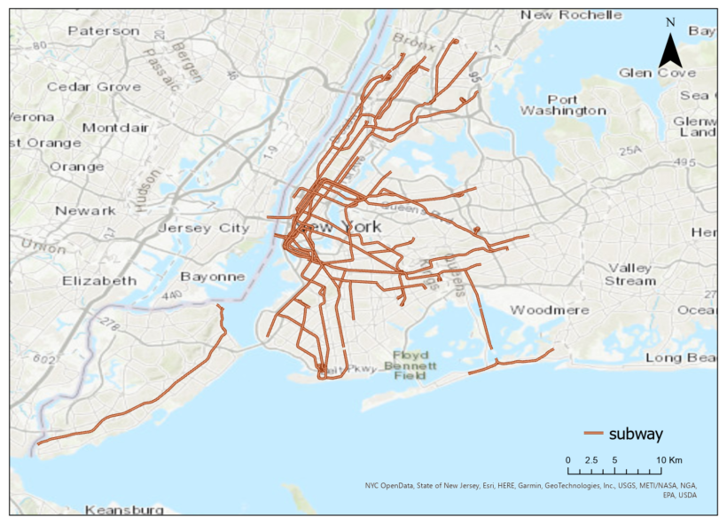
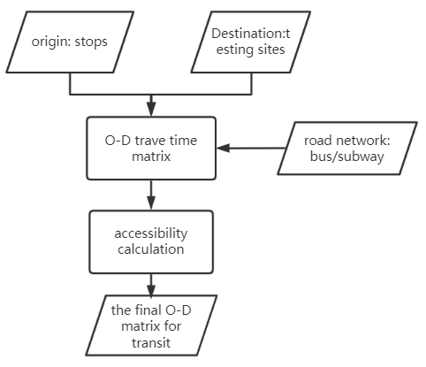
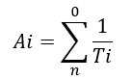
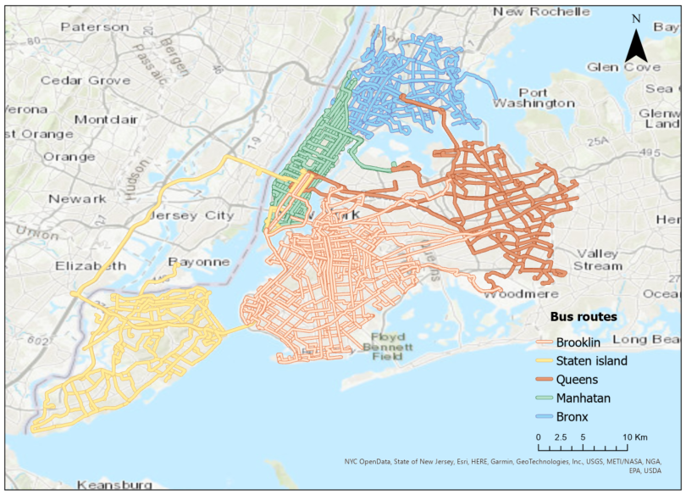
Accessibility: transit
Where n stands for the count of testing sites that can be reached within 15 minutes of taking the subway or buses, while Ti is the time people spend getting to each testing site starting from stop i.
Notes:
To evaluate how transit improves the accessibility, subways and buses, two dominant transit systems, are chosen and their accessibilities are calculated differently from the non-transit modes, since transit routes and schedules are fixable with given stops that travelers should take., the transit road network for subway and bus are built based on the GTFS data. The transit accessibility of each stop is calculated as the following equation:
The speeds of taking the subway and bus are set to 28km/h and 13km/h respectively. To build a comprehensive transit road network system, pedestrian road network is combined with the subway or bus route system, since when getting off the nearest stops to the testing sites, people still need to walk for a while to reach their final destination, the testing sites.
起点设成stop，因为交通路网相对死板
考虑到实际中，人们下了地铁站还要走一段路，所以combine了行人路网

Slide 9
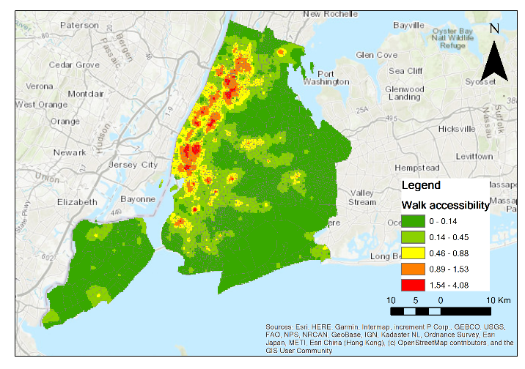
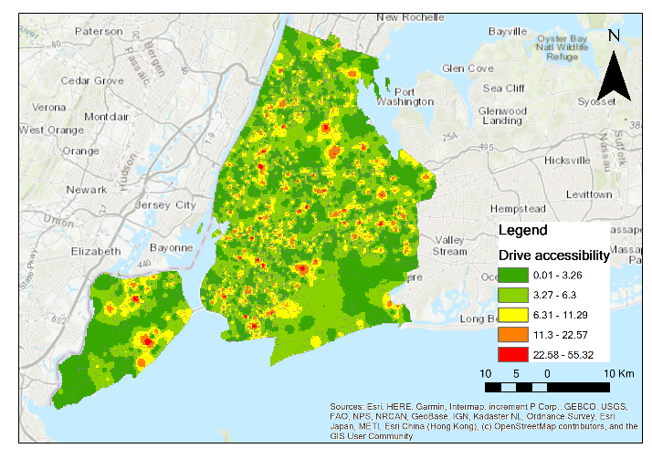
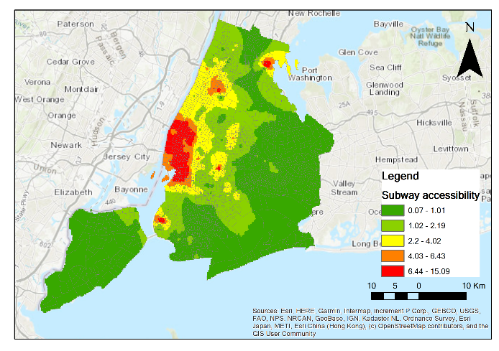
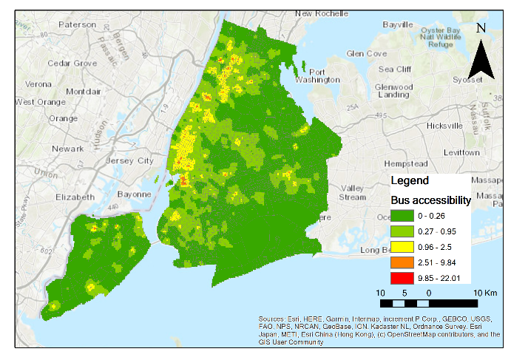
a.
b.
Non-transit
Walk
Drive
Transit
c. Subway
d. Bus
c.
d.
Notes:
. Walk accessibility indicates a tightly clustering distribution pattern, which is highest in Manhattan and decreases gradually to the edge. In contrast, the distribution of drive accessibility is random, with a few highest regions in Manhattan and Brooklyn, Queens and Staten Island. The accessibility enhances significantly from walking to driving, since ideally with driving, people can access to more testing sites within a shorter time. However, in reality the driving accessibility will be less than this study shows, considering the traffic congestion and parking issues. Transit accessibility is highest in Manhattan and decay gradually to the boundary of NYC. Most regions are more accessible to subways than bus, since typically subways take shorter time to wait and hardly encounter traffic jam, despite that there are much more bus stations than subways in NYC.
除了driving 其他三个都很cluster，从中心到边远依次递减。
在现实中，这些accessibility计算会更低一些，因为还要考虑到人们等车，等红绿灯，堵车的时间（future work）

Slide 10
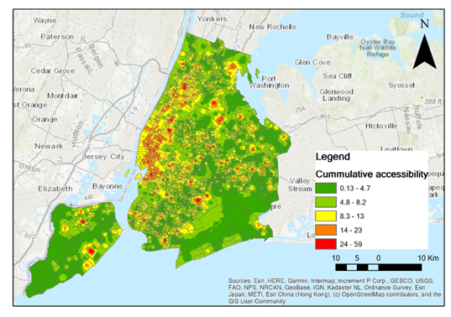

Slide 11
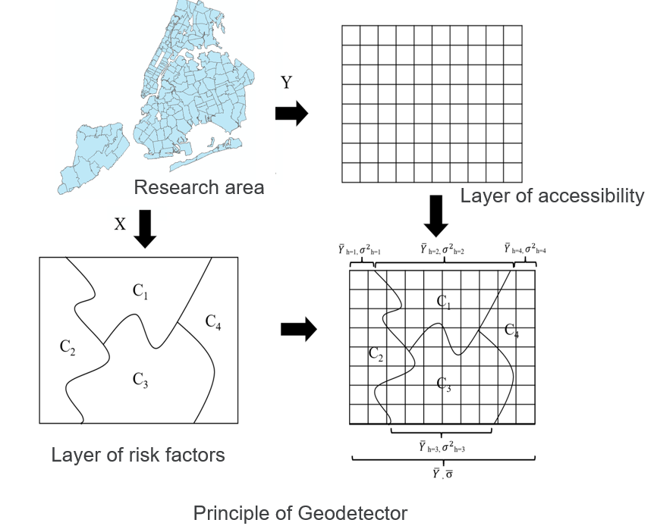
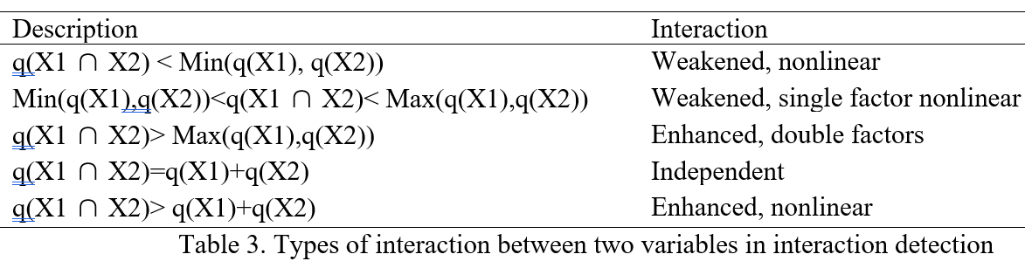
Geodetector
Data classification method:
Equal interval
Natural jenks
Geometric interval
Quantile (finally choose)
Notes:
In the last part, I explored the influencing factors of spatial accessibility with a modal called Geodetector. In this study, Y input stands for the spatial accessibility values of each census tract, and X input stands for influnceing factors. To conduct such modal,

Slide 12
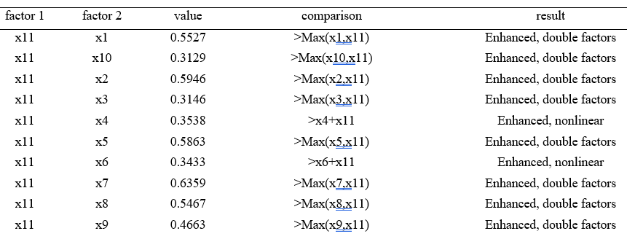
Geodetector
Influencing factor | q-statistic | p-value
Population density | 0.4398 | 0.0000
Median Income | 0.4239 | 0.0000
Median Age | 0.0744 | 0.0128
White (%) | 0.0687 | 0.0229
Bachelor (%) | 0.4328 | 0.0000
Public Transport (%) | 0.1400 | 0.0001
COVID Positive Rate | 0.5060 | 0.0000
Testing site Density | 0.4994 | 0.0000
Transit Road Density | 0.2910 | 0.0000
Non-Transit Road Density | 0.1591 | 0.0000
Transit stop density | 0.1702 | 0.0000
Table 1. factor detection results of influencing factors
Table 2. Results of interaction detection (X1 - Population density, X2 - Median Income, X3 - Median Age, X4 - White(%), X5 - Bachelor (%), X6 - Public Transport (%), X7 – COVID-19 Positive Rate, X8 - Testing site Density, X9 - Transit Road Density, X10 – Non-transit Road Density, X11 - Stop density)

Slide 13
Summary
Accessibility to testing sites was found to be heterogeneous across NYC and among different travel modes.
COVID-19 positive rate, population density and the testing sites density were strong indicators in affecting the spatial accessibility.
Spatial accessibility
Influencing factors
Expand the testing sites capacity, build new transit routes, provide visiting health care programs in areas with low accessibility.
The peak and off-peak driving speed, the bus and subway time schedule, should be incorporated in building a more accurate multimodal network.
Recommendation
Future work

Slide 14
Thanks! Q&A

